Slide 1


TESTING AND VALIDATION OF AUTOMATED ROAD VEHICLES FINAL PROJECT 2025-2026
SYSTEM UNDER TEST (SUT): ADAPTIVE CRUISE CONTROL (ACC)
PROJECT GUIDE: Prof. Angelo Coppola
D18000070: Pars Oner
D18000065 Adithya Zacharia Valavi

Slide 2


INTRODUCTION
Aim:
Define and model the system under test – SUT​
Model the Ego-Vehicle dynamics​
Identify a test case​
Identify and describe input variables, possible range of variations and possible impacts on the behavior of the system​.
Design a test-plan (ODD assumptions + pass/fail thresholds + reproducibility (seed/config))

Slide 3
PROJECT OBJECTIVE
Evaluate ACC safety performance under diverse simulated conditions.
Use Latin Hypercube Sampling to vary vehicle, road, and driver parameters
Run 210 Simulink simulations to capture system behavior
Compute safety KPIs
Identify safe vs. unsafe parameter regions

Slide 4
METHODOLOGY
PARAMETERS RANGE
Vehicle
Driver
Environment
LATIN HYPERCUBE SAMPLING (LHS)
Generate 210 samples
SIMULINK ACC SIMULATION
ACC Controller
Vehicle Dynamics
Lead Vehicle Model
ANALYSIS & VISUALIZATION
Scatter plots
PDF curves
CDF safety thresholds
Sensitivity trends
COLLECT RESULTS
Stores the input parameters and output KPIs for every simulation performed using Latin Hypercube Sampling (LHS)in resultsLHS struct
KPI EVALUATION BLOCK
TTC max
TTC min
Violation rate
Acceleration max
Acceleration min

Slide 5
TEST STRATEGIES
TEST ENVIRONMENT: MODEL-IN-THE-LOOP (MIL)
The ACC control logic is implemented in Simulink
Vehicle dynamics and lead vehicle behavior are modeled
Parameters are varied using Latin Hypercube Sampling
Safety: TTC_min, viol_rate; Comfort/actuation: a_min, a_max are extracted.
REQUIREMENTS-BASED TESTING (FUNCTIONAL TEST)
In ACC, this checks:
Does ACC maintain the required time gap?
Does it brake when TTC becomes critical?
Does it respect speed setpoint limits?
In our project:
Requirements is TTC_min ≥ threshold and violation_rate ≤ limit
Failures indicate functional insufficiencies (SOTIF Type-2 scenarios i.e known unsafe / Unknown unsafe)

Slide 6
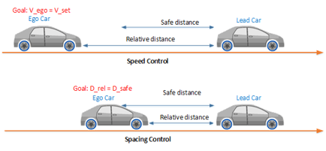
ADAPTIVE CRUISE CONTROL (ACC) SYSTEMS
Maintains a set speed and safe distance to the lead vehicle
Adjusts acceleration and braking automatically
Key inputs: distance, relative speed, time gap
Safety depends on driver-selected settings and controller/sensing assumptions

Slide 7
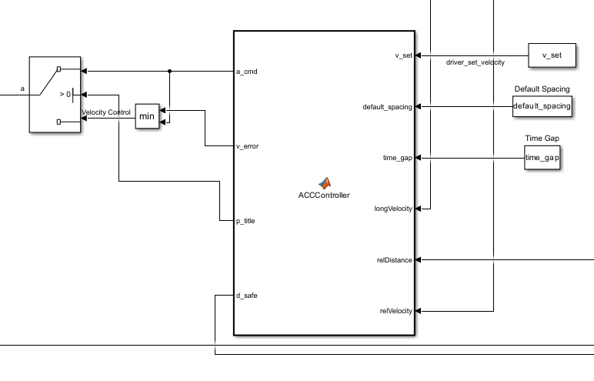
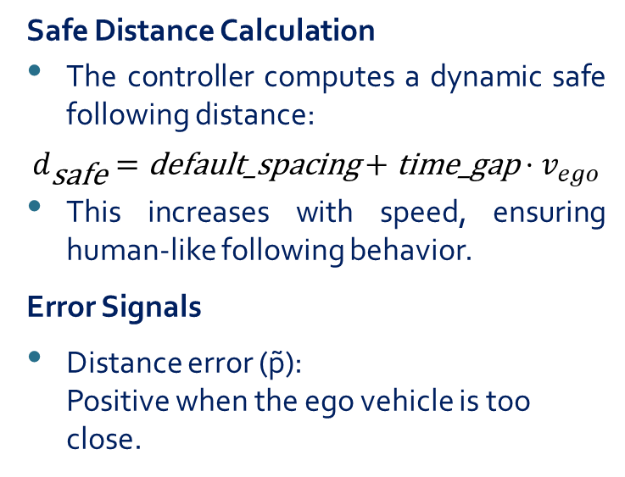
ADAPTIVE CRUISE CONTROLLER
Regulates longitudinal motion to maintain a safe distance behind the lead vehicle.
Switches naturally between speed control and distance control mode. Switch condition: if lead detected and gap < desired then distance-control else speed-controls.
Safe Distance Calculation
The controller computes a dynamic safe following distance:
$$d_{\text{safe}}=\text{default}\text{_}\text{spacing}+\text{time}\text{_}\text{gap}⋅v_{ego}$$
This increases with speed, ensuring human-like following behavior.
Error Signals
Distance error (p̃): Positive when the ego vehicle is too close.

Slide 8
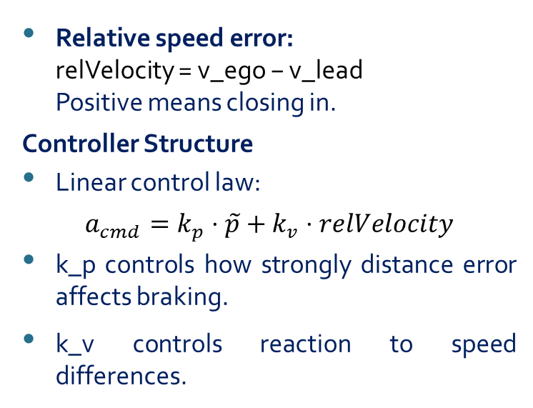
ADAPTIVE CRUISE CONTROLLER (Contd..)
Relative speed error: relVelocity = v_ego − v_lead Positive means closing in.
Controller Structure
Linear control law:
$$a_{cmd}=k_{p}⋅\tilde{p}+k_{v}⋅relVelocity$$
k_p controls how strongly distance error affects braking.
k_v controls reaction to speed differences.
Lead Vehicle Logic
If relDistance == 0, the controller assumes no valid lead vehicle and avoids abrupt transitions.
Acceleration Saturation
Physical limits:
Max acceleration: +2.0 m/s²
Max braking: –7.5 m/s²
Physical/emergency bound; comfort bound handled via jerk/soft limit.

Slide 9
LATIN HYPERCUBE SAMPLING
WHY LATIN HYPERCUBE SAMPLING (LHS)?
Efficient sampling of multi-dimensional parameter space
Ensures better coverage of parameter ranges
Avoids clustering seen in random sampling
With 210 simulations, more efficient than thousands scenario.

Slide 10
Define Parameter Ranges
The function sets min/max values for:
Speed setpoint (15–35 m/s)
Time gap (0.9–2.3 s)
Default spacing (2.5–7 m)
Vehicle mass (900–1600 kg)
Aerodynamic drag factor Cd·Af (0.25*1.8, 0.35*2.3)
Rolling resistance coefficient Cr
Road slope θ (–0.035 to +0.07 rad)
Input Handling
Accepts number of simulations N (default: 210)
Ensures Simulink model CCToACCFinal1 is loaded
Latin Hypercube Sampling
Generate an N × 7 matrix of LHS samples
Convert normalized values into physical parameter values
Ensures even coverage of multidimensional parameter space
KPI Extraction Details
TTC_min → last value of TTC signal (worst-case TTC)
viol_rate → final violation metric from KPI block
a_max → highest acceleration during simulation
a_min → strongest braking during simulation
Preallocate Results Structure
Creates resultsLHS(N,1) with fields: v_set, time_gap, default_spacing, m, Cd_air, Cr, theta,TTC_min, viol_rate, a_max, a_min
This improves performance and organizes final results.
Main Simulation Loop
For each of the N simulations:
Assign sampled parameters to MATLAB base workspace
Run the Simulink model for 40 seconds
Retrieve KPI signals from the output
Interpret KPIs from timeseries or numeric data
Speeds up repeated simulations by avoiding recompilation
Post-Processing
Converts struct to table using struct2table()
Prints the table to the console
Exports results to base workspace (resultsLHS)

Slide 11
KEY PARAMETER INDEX
KPI Block: What We Measure
TTC (Time-To-Collision): instantaneous collision risk
TTC_min: minimum TTC during interaction
Violation Rate: how long/deep the safe distance was violated (rate = time_fraction(distance < d_safe) (severity = mean/max(d_safe - distance)+)
a_max / a_min: max acceleration & max braking
Uses persistent states to track metrics over entire run
Considers both duration and severity of unsafe situations (distance < d_safe)
Ignores unrealistic TTC values using validity bounds and interaction zone (valid TTC when relSpeed< 0)
Produces final scalar KPIs that are stored in resultsLHS for analysis
Input
TTC Calculation
Violation Logic
Acceleration Extremes
Outputs

Slide 12
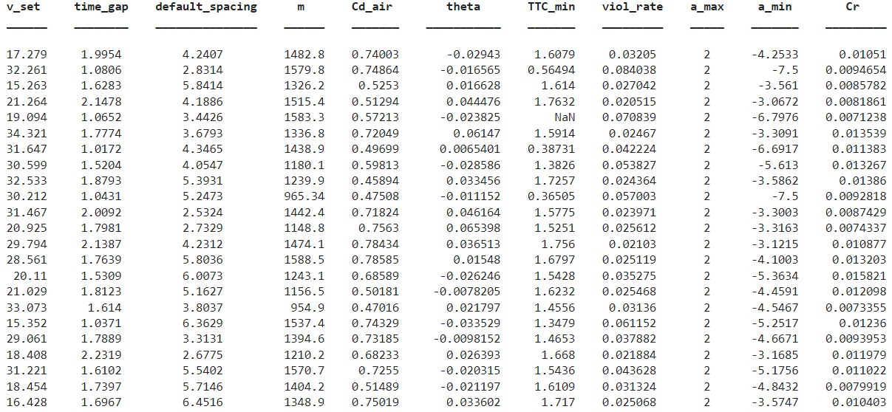
RESULTS
Notes:
Hard braking is a consequence of low TTC, not the main cause.

Slide 13
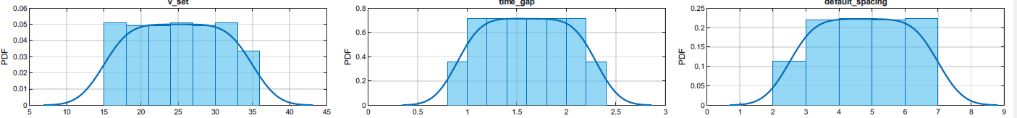
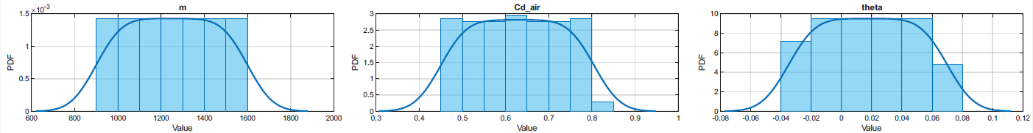
RESULTS (Contd..)
LHS spreads speed values evenly across the entire range
No clustering → good coverage of speed scenarios
Inference :Speed sampling is well-distributed, enabling robust safety evaluation.
Good coverage across all human-like following gaps
Higher density between 1.3–1.8 s, which is realistic
Inference :Time gap samples cover both unsafe (small) and safe (large) regions evenly
Even sampling of close and far spacing settings
Inference :Allows testing of ACC behavior from short to long baseline spacing.
Covers small, medium, and large vehicle masses
Inference :Ensures simulation includes light cars and heavier SUVs/EVs
Mid-range aero conditions sampled more often.
Inference :Captures variability from sleek sedans to boxy SUVs
Includes downhill, flat, and uphill segments
Inference:Realistic slope effects included for dynamic load variation

Slide 14
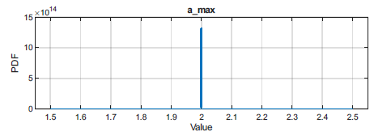
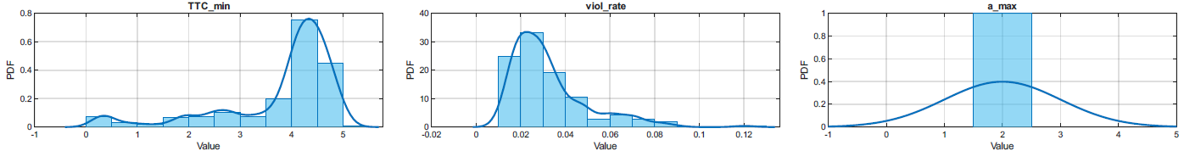
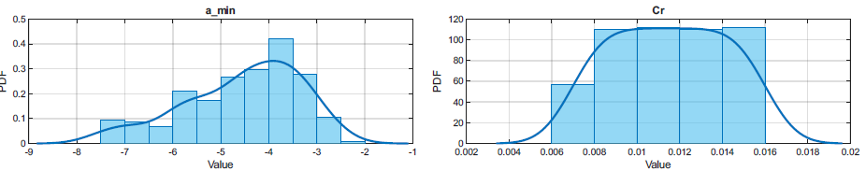
RESULTS (Contd..)
A cluster near low TTC (~1 s) → unsafe cases
Another peak near ~4–5 s → safe cases
Inference :The system experiences both safe and unsafe interactions depending on parameters.
Most simulations have low viol_rate (safe)
A minority exceed 0.1 (unsafe)
Inference :Unsafe violations are rare but clearly present in sampled scenarios.
ACC frequently hits its max acceleration ceiling
Inference :The controller uses nearly full acceleration often, showing assertive speed tracking.
Moderate braking appears most often
Heavy braking (< –6 m/s²) occurs but less frequently
Inference :Hard braking events coincide with low TTC and unsafe encounters
Covers good variety of tire/road combinations
Inference :Rolling resistance variability is included but not strongly affecting safety KPIs.

Slide 15
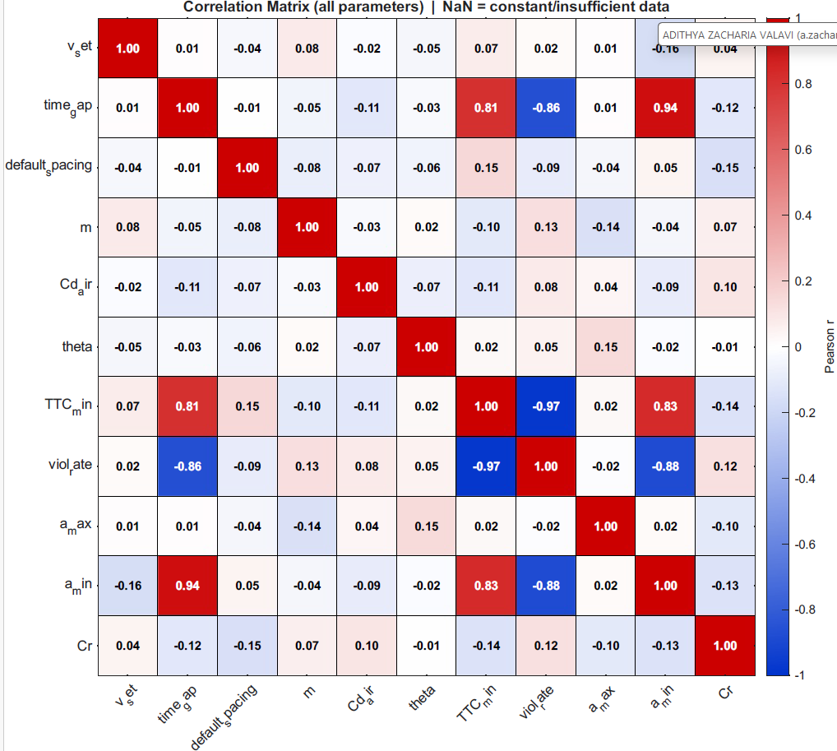
RESULTS (Contd..)
The correlation matrix quantifies linear relationships between ACC parameters and KPIs.
Time gap shows strong positive correlation with TTC_min and strong negative correlation with violation rate.
TTC_min and violation rate are almost perfectly negatively correlated, confirming their role as core safety indicators.
Minimum acceleration (a_min) is strongly linked to safety, reflecting emergency braking in risky scenarios.
Vehicle physical parameters show weak correlations, indicating limited influence compared to control parameters.

Slide 16
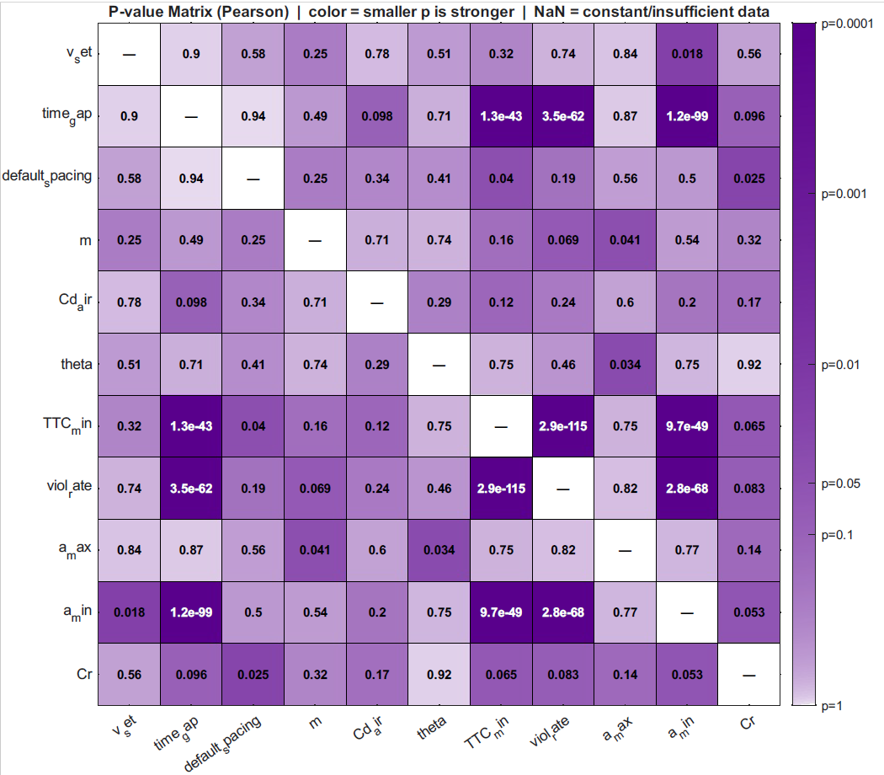
RESULTS (Contd..)
The p-value matrix shows the statistical significance of relationships between ACC parameters and KPIs.
Small p-values (p < 0.05) indicate a meaningful relationship. P indicates significance; r indicates effect size.
Time gap is the most influential parameter, strongly affecting TTC_min, violation rate, and braking.
TTC_min and violation rate are strongly correlated, confirming their role as key safety indicators.
Vehicle physical parameters (mass, drag, resistance, slope) show weaker influence on ACC safety outcomes.

Slide 17
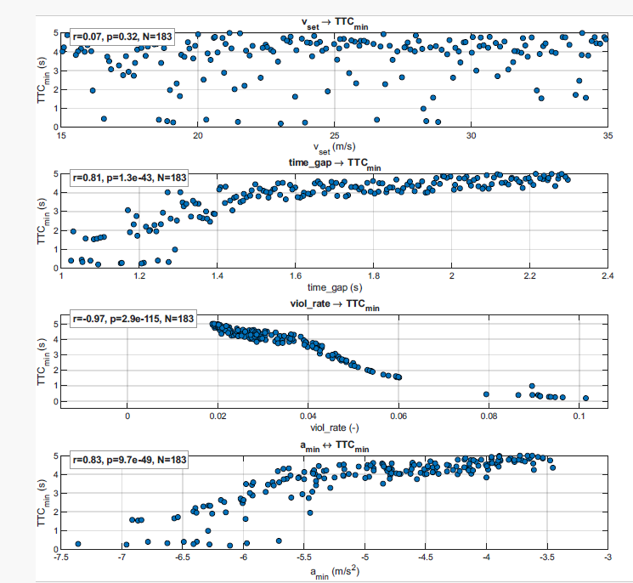
RESULTS
r = 0.07, p = 0.32
Points are scattered with no clear trend
Inference :Vehicle speed has almost no effect on TTC_min in this dataset.
Very small gaps (<1.2 s) → many unsafe TTC_min values.
Medium gaps (1.4–1.7 s) → TTC_min improves.
Large gaps (>1.7 s) → consistently high TTC_min (safe).
r = 0.81, p = 1.3e-43 Clear upward trend
Inference :Time gap is the strongest safety parameter—larger gaps drastically improve TTC_min.
viol_rate < 0.04 → TTC_min stays high (safe).
viol_rate > 0.06 → TTC_min quickly becomes unsafe.
r = −0.97, p = 2.9e-115, Strong downward trend
Strong negative correlation: more violations → closer to collision.
Inference :Violation rate is a highly reliable predictor on low TTC values.
Strong braking (–6 to –8 m/s²) → often low TTC_min values.
Mild braking (–3 to –4 m/s²) → safe TTC_min
r = 0.83, p = 9.7e-49 Clear positive trend
Inference : consistent with braking being associated with low TTC.
Notes:
Hard braking is a consequence of low TTC, not the main cause.

Slide 18
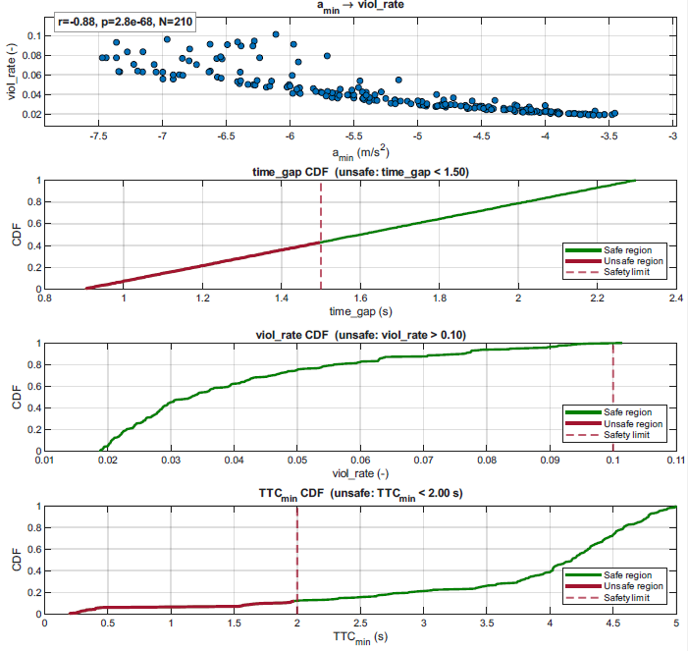
RESULTS (Contd..)
Mild braking (–3 to –4 m/s²) → low viol_rate (safe).
Strong braking (–6 to –8 m/s²) often occurs with high viol_rate.
r = −0.88, p ≈ 0 Strong downward trend
Inference :violations happen in critical braking scenarios
A significant number of simulations fall into the unsafe time-gap region.
Shows probability of unsafe time-gap selection across LHS design.
Inference :Time gaps below 1.5 s occur frequently and pose a safety risk
Most simulations fall below 0.08 → generally safe.Only a small tail exceeds 0.10 → critical risk zone.
Inference :Only a small subset of scenarios show severe safety violations > 0.10.
Many simulations fall below 2.0 s → unsafe interactions
Long tail above 2.0 s suggests a mix of safe and unsafe scenarios
Inference :A significant portion of LHS scenarios produce TTC_min < 2 seconds—indicating ACC can become unsafe under certain parameter combinations..

Slide 19
CONCLUSION
Time Gap is the strongest safety factor— values <1.5 s frequently unsafe
Low violation rate corresponds to high TTC_min
Safe region primarily driven by time gap; braking severity correlates with risk; speed effect not significant in this dataset.
ACC safety highly sensitive to time gap settings
LHS provides efficient system-wide evaluation
KPI block effectively identifies dangerous situations

Slide 20
THANK YOU

